Slide 1
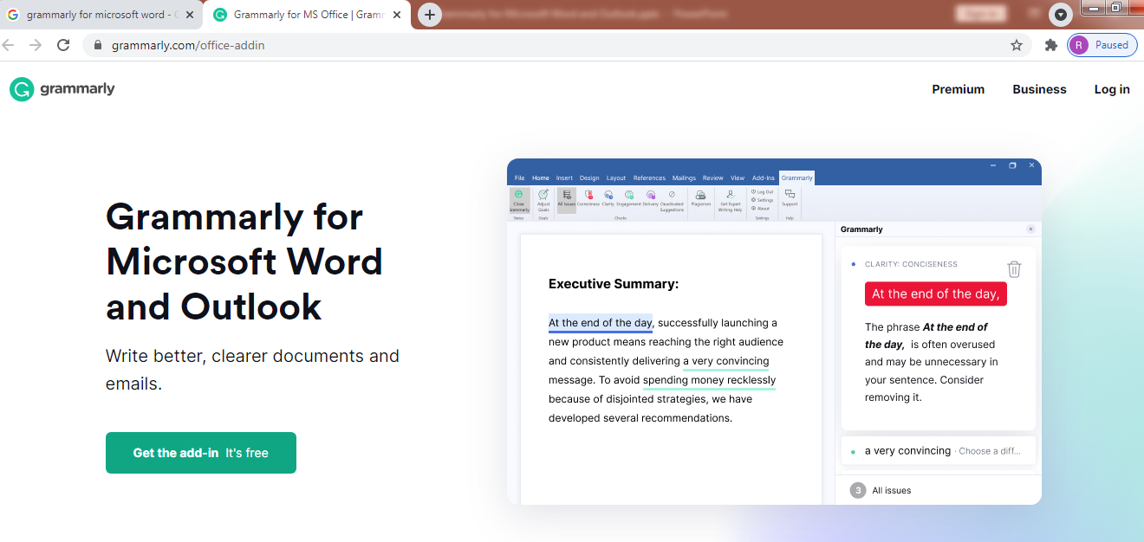
Grammarly for Microsoft Word and Outlook
https://www.grammarly.com/office-addin

